Slide 1


Spatial Transcriptome with R programming
2023 The 19th KOGO Winter Workshop
2023. 2. 1. Wed
Choi Lab
Korea University College of Medicine

Slide 2
Table of Contents
What is R programming?
Space Ranger
Human DLPFC workflow
Load data
Quality control
Normalization
Feature selection
Dimensionality reduction
Clustering
Marker genes
Github repository for the workshop : https://github.com/parkjooyoung99/KOGO_2023

Slide 3
What is R programming?
1

Slide 4



What is R and Why R?
R is used widely in biological research, and provides a solid platform for beginner scientific programmers.
Many graphing and statistical operations are built right into the language.
It’s free and open-source.
It runs on all major operating systems.
R is the most common statistics platform in genomics. And easy to use.
Bioconductor uses the R statistical programming language, and is open source and open development.
Modified from : https://datacarpentry.org/semester-biology/about/why-r/
https://www.bioconductor.org/

Slide 5
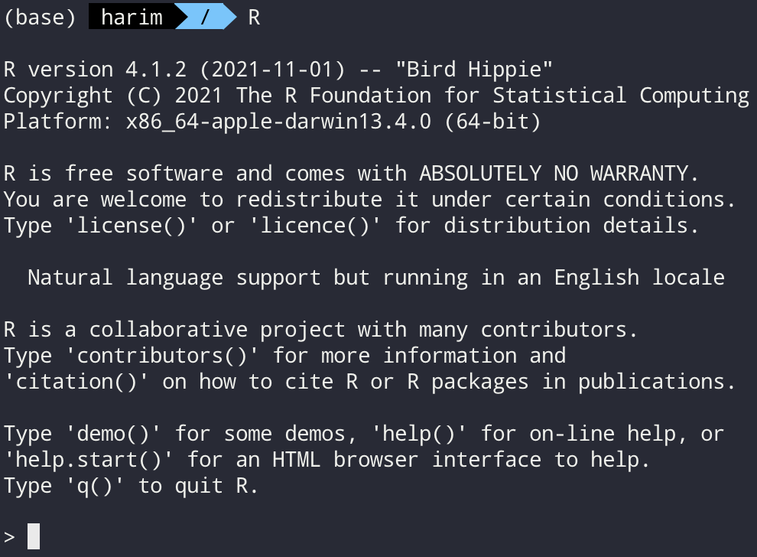
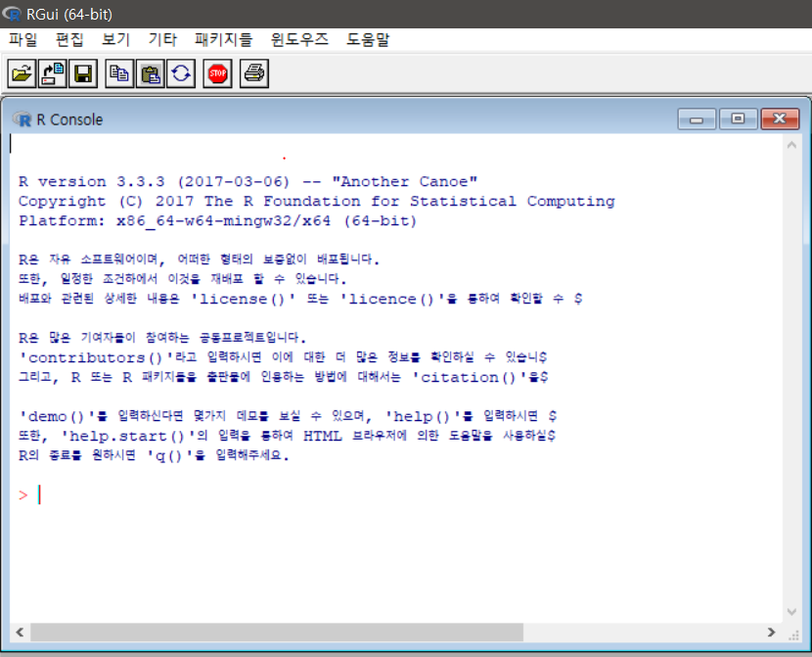
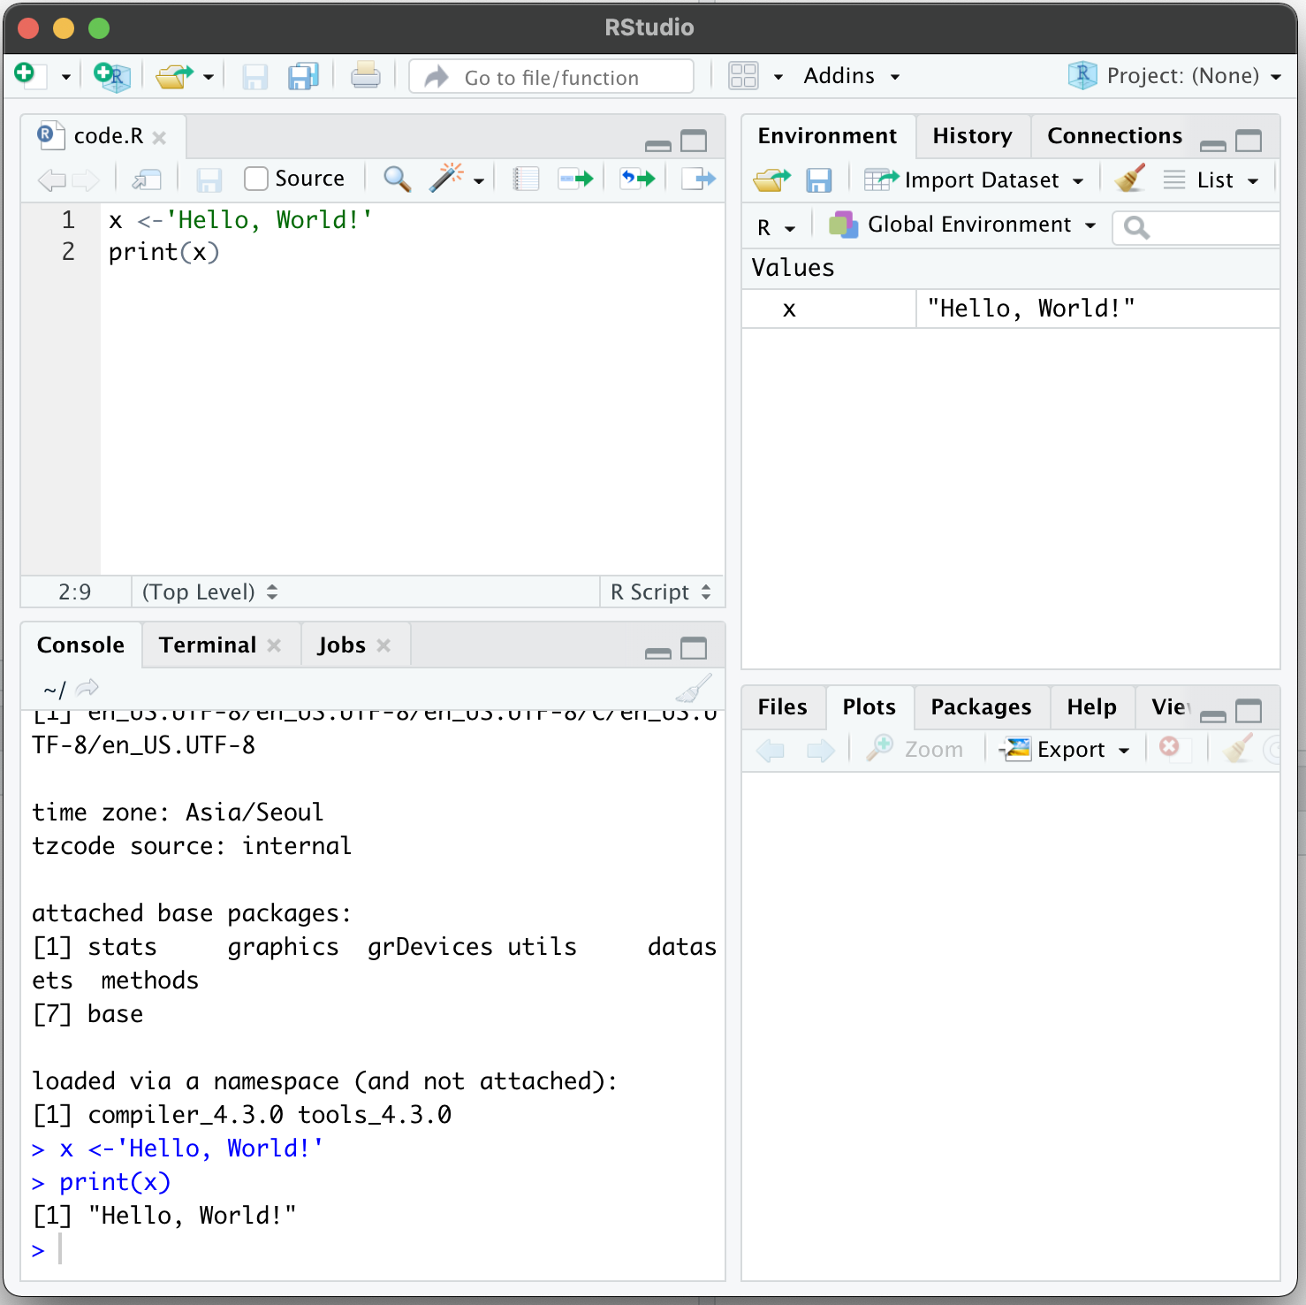
Several ways to use R
Command line
Graphical user interface
Rstudio

Slide 6
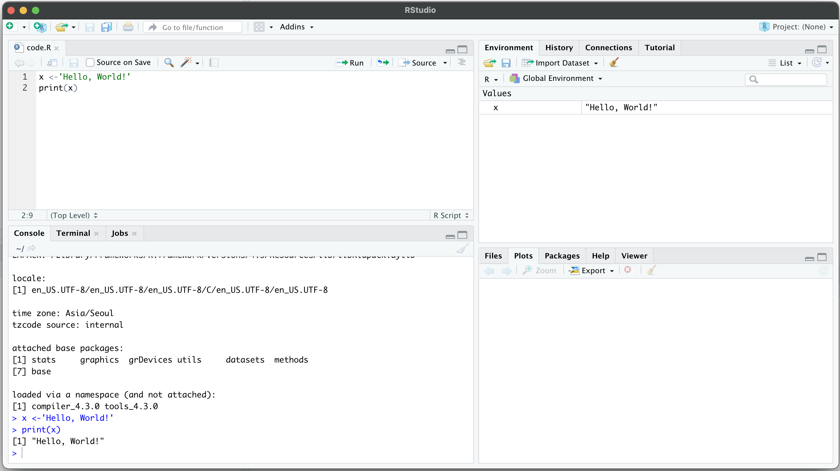
Rstudio
Rstudio – Integrated development environment (IDE) for R and python
Code editor
Environment / History
R console
Other panes
(Files, Plots, Packages, Help)

Slide 7
Space Ranger
2

Slide 8
What is Space Ranger?
Space Ranger is a set of analysis pipelines for processing 10X Genomics Visium sequence data (FASTQ files) with high resolution microscope images of tissue.
It maps the transcriptomic reads to the microscope image of the tissue from which the reads were obtained
We will introduce spaceranger count pipeline among the 5 pipelines

Slide 9
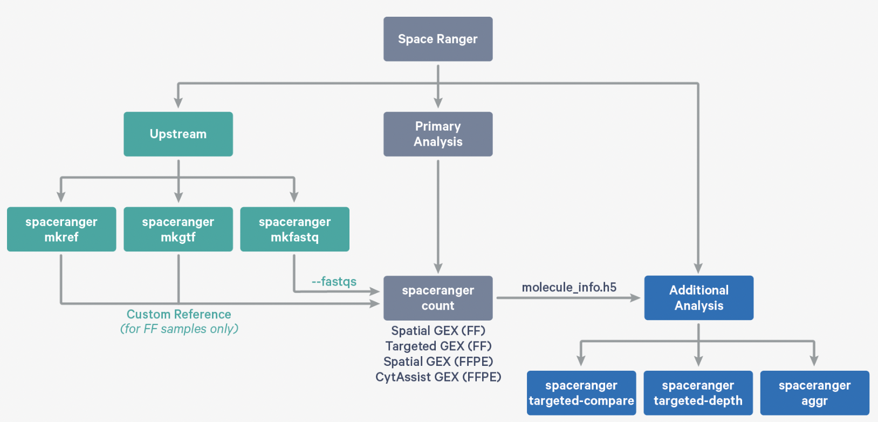
Space Ranger Pipelines
spaceranger mkfastq
spaceranger count
spaceranger aggr
spaceranger targeted-compare
spaceranger targeted-depth
https://support.10xgenomics.com/spatial-gene-expression/software/pipelines/latest/what-is-space-ranger

Slide 10
Installing Space Ranger
Download and unpack the Space Ranger .tar.gz file in any location
Download and unpack proper reference data .tar.gz file in a convenient location
3. Pre-pend the Space Ranger directory to your $PATH
https://support.10xgenomics.com/spatial-gene-expression/software/pipelines/latest/installation

Slide 11
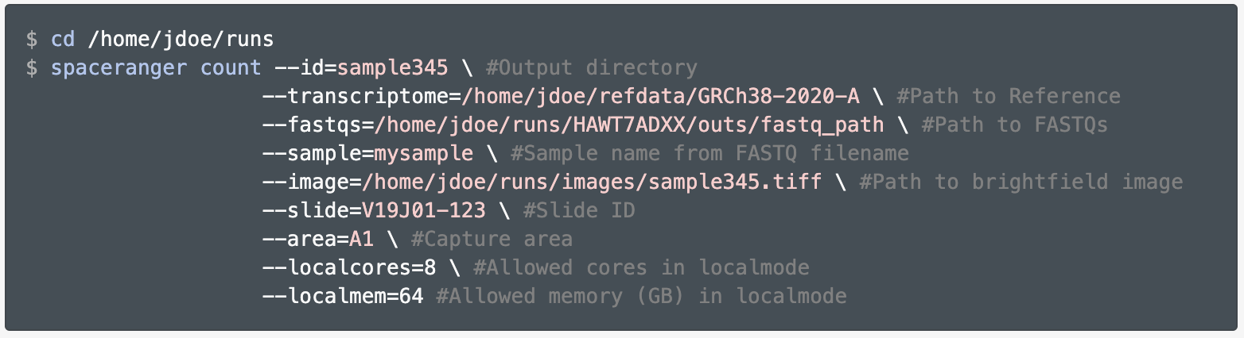
Run spaceranger count command
https://support.10xgenomics.com/spatial-gene-expression/software/pipelines/latest/using/count
Input : the microscope image (.tiff), FASTQ files(Fastq)
Perform : sequence alignment, tissue detection
Output : gene-spot matrix

Slide 12
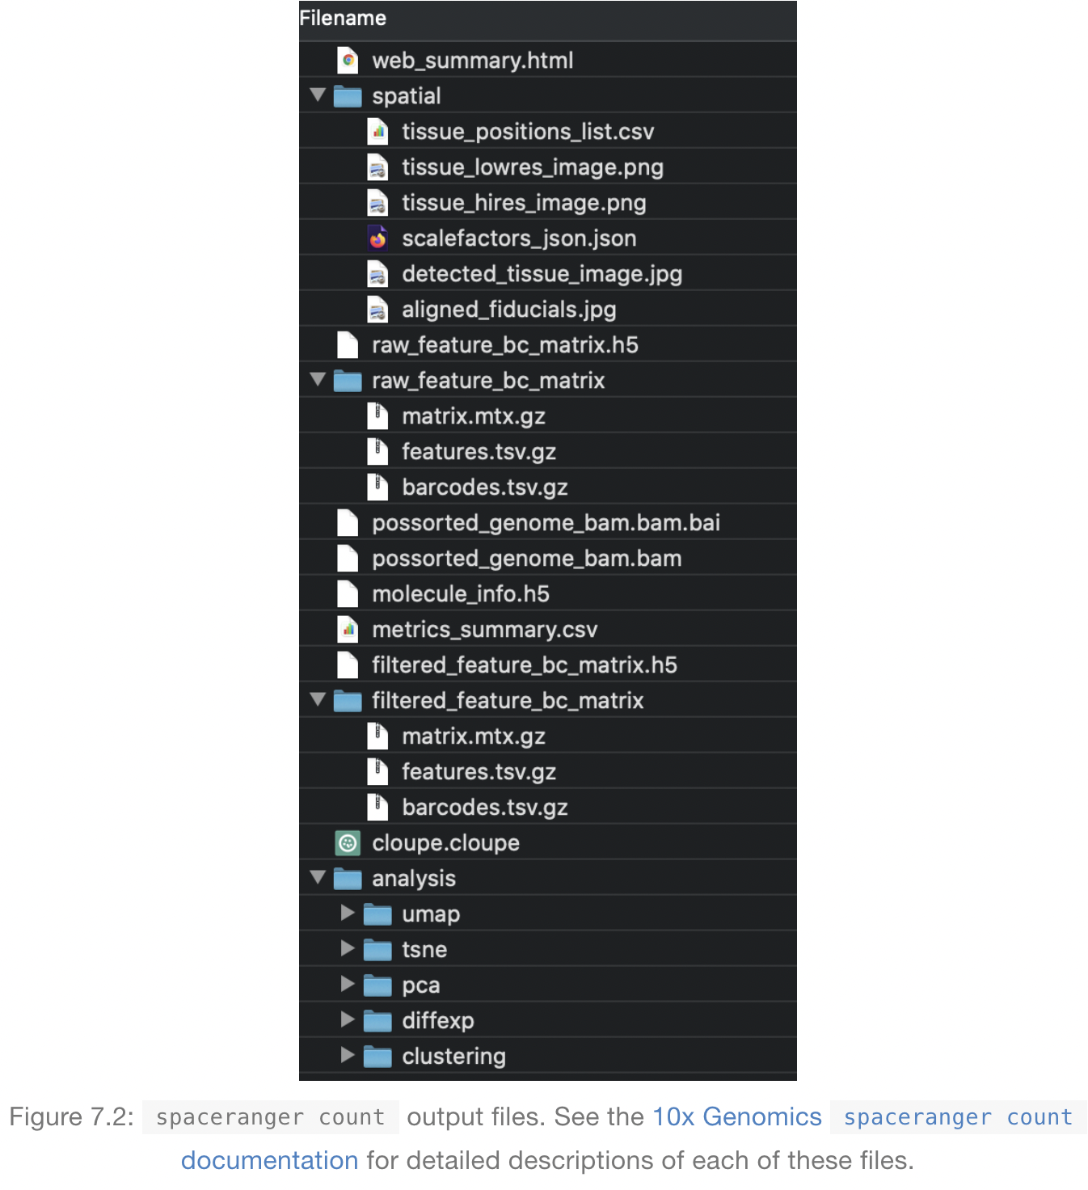
Output files of Space Ranger
read10XVisium Input files
https://lmweber.org/OSTA-book/space-ranger-visium.html

Slide 13
Output files
raw_feature_bc_matrix
Inspect the data in spots that theoretically don’t overlap your tissue
filtered_feature_bc_matrix
Data filtered to the spots overlapping tissue, as determined by your Loupe Browser.
(Visium) alignment file
tissue_positions_list.csv
The spot coordinates information is stored
scalefactors_json.json
Includes the scaling factors to convert spot coordinates to pixel coordinates
metrics_summary.csv
Includes the metrics displayed in the interactive website
web_summary.html
Interactive website

Slide 14
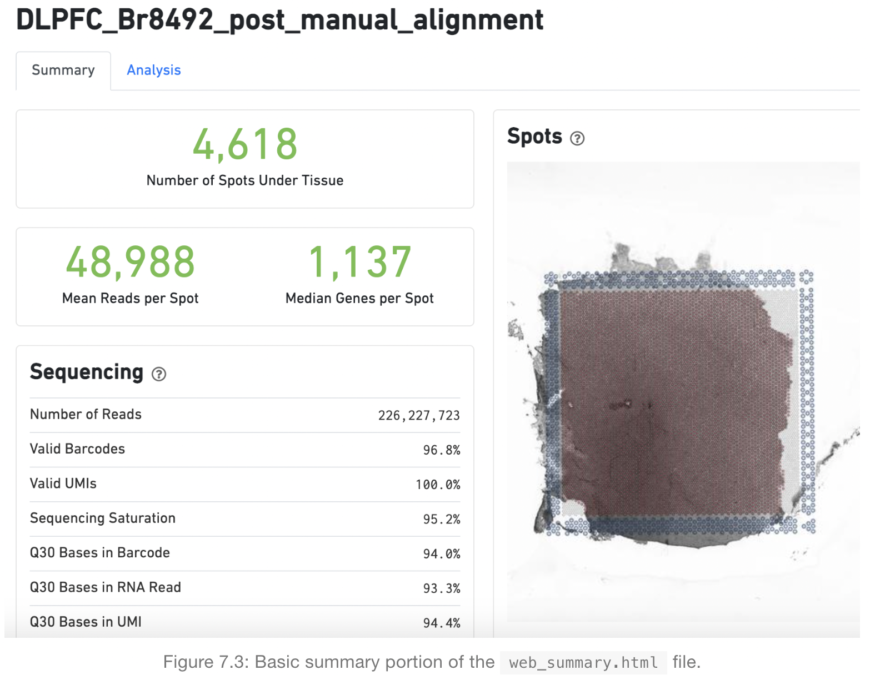
Web summary .html file
Sequencing Saturation
The fraction of reads originating from an
already-observed UMI. Function of library
complexity and sequencing depth
Q30 Bases
Fraction of bases with Q-score >= 30,
excluding very low quality/no-call (Q <= 2)
bases from the denominator
https://lmweber.org/OSTA-book/space-ranger-visium.html

Slide 15
What is a Loupe Browser?
Loupe Browser is a desktop application from 10x Genomics that allows you to visualize your gene expression data without having to write code
Manual alignment of images
We usually use the Loupe Browser to align gene expression spots to histological images, look for marker gene expression, annotate populations, and cluster
The .cloupe file is the one you need to import into the Loupe Browser in order to explore your processed data. These files are generally between 1 and 2 GB each.

Slide 16
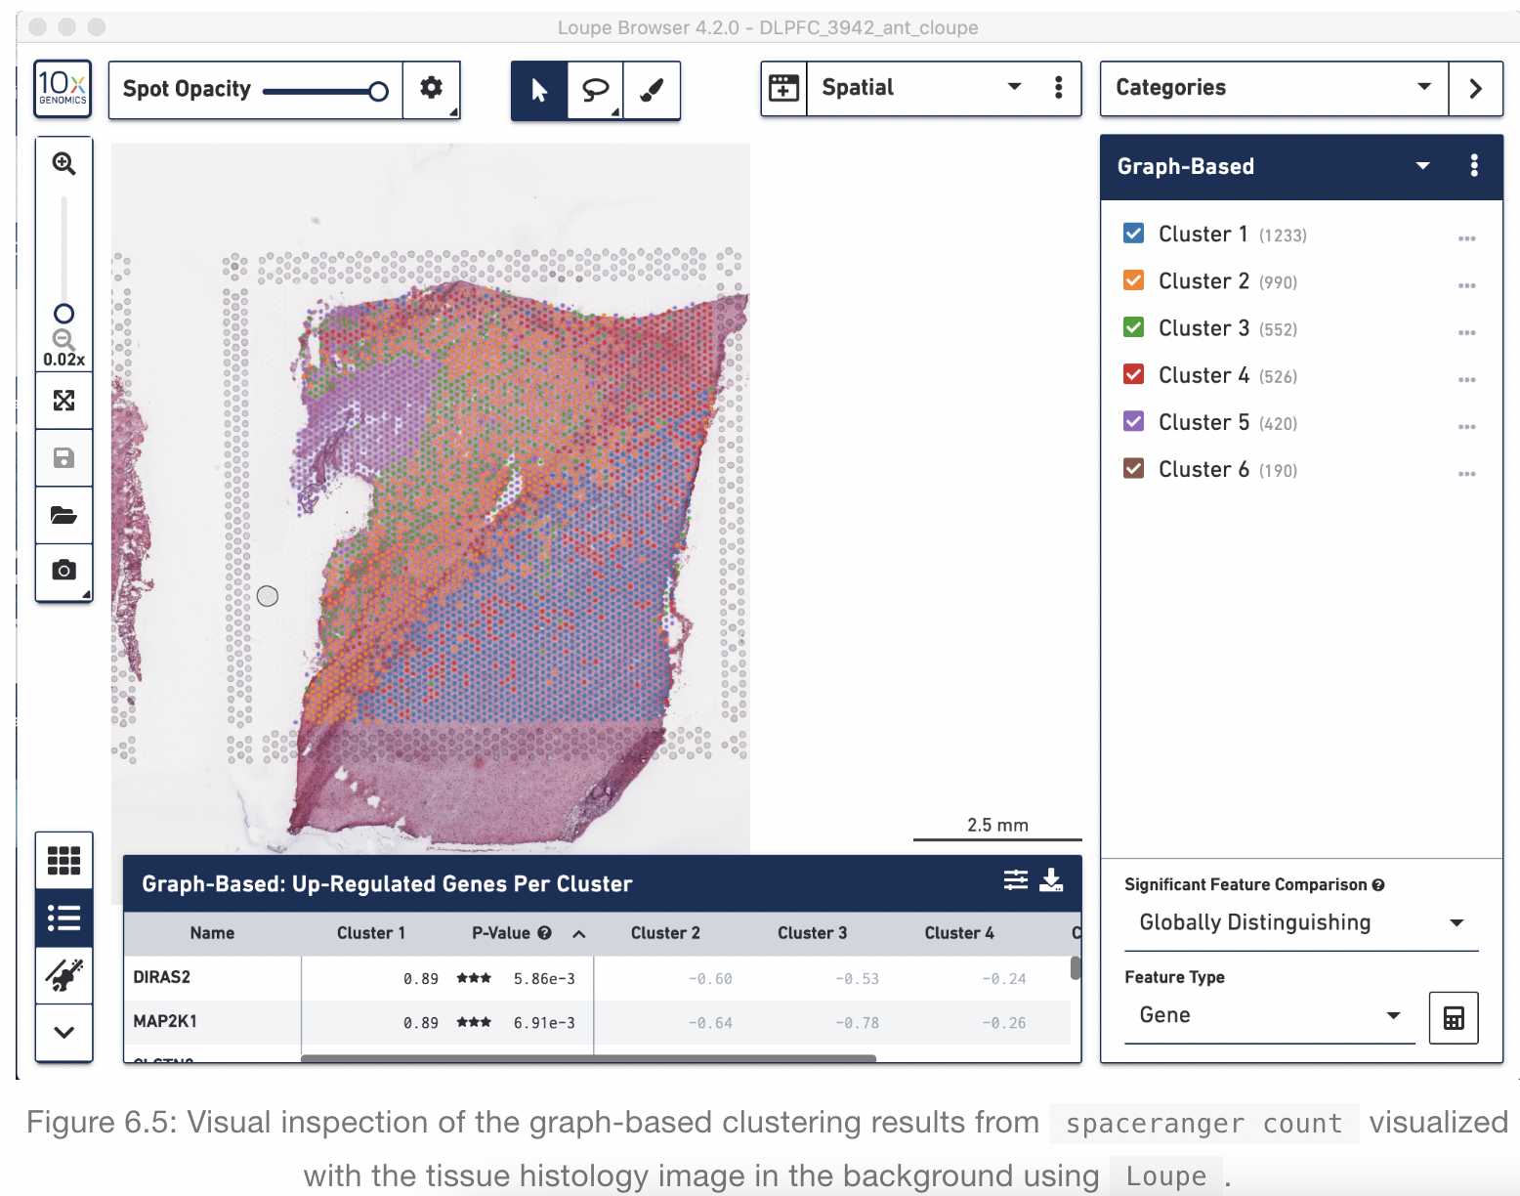
Loupe Browser
Histology image &
UMAP & t-SNE
Manual Annotation of spots
https://support.10xgenomics.com/spatial-gene-expression/software/visualization/latest/analysis

Slide 17
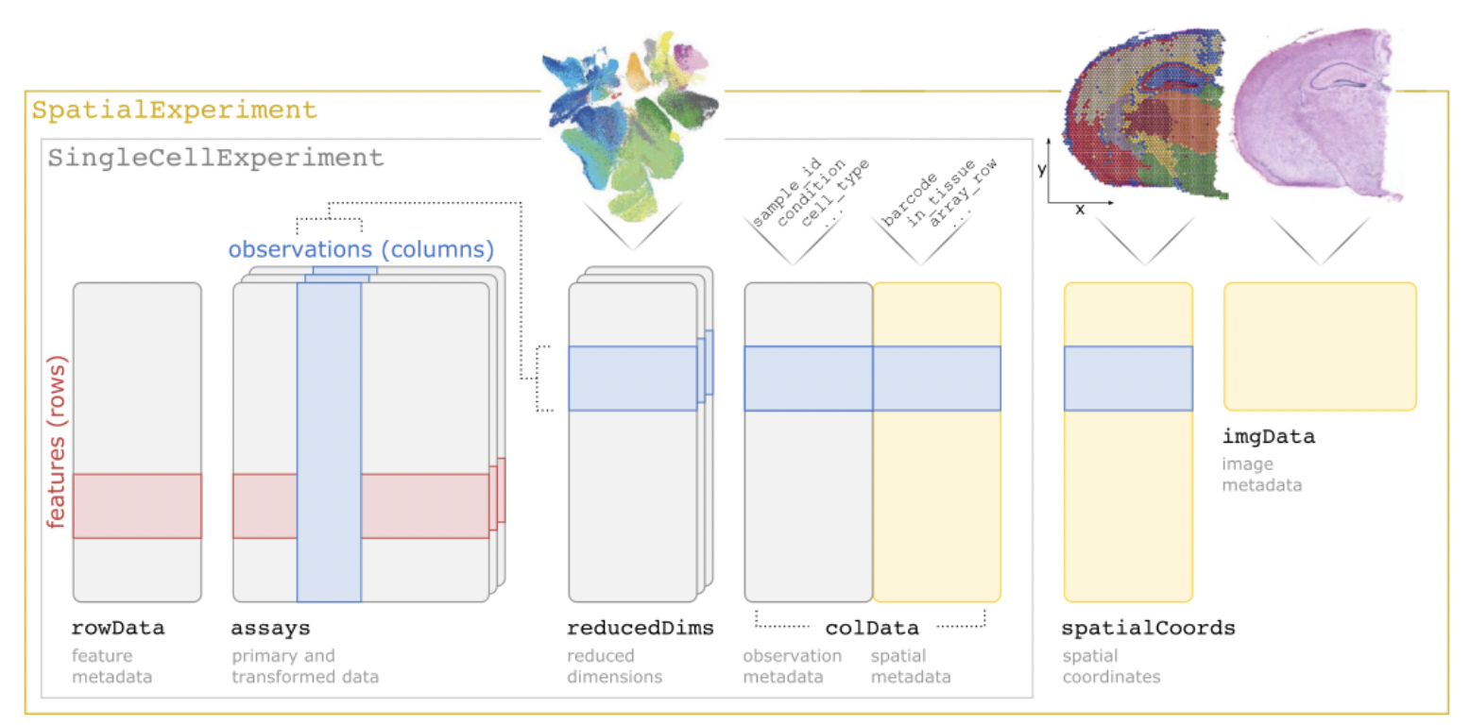
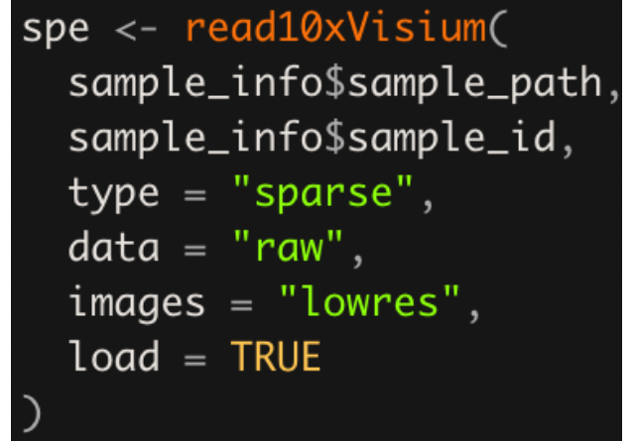
Load a Visium dataset in R as a SpatialExperiment
https://lmweber.org/OSTA-book/spatialexperiment.html

Slide 18
Human DLPFC workflow
3

Slide 19
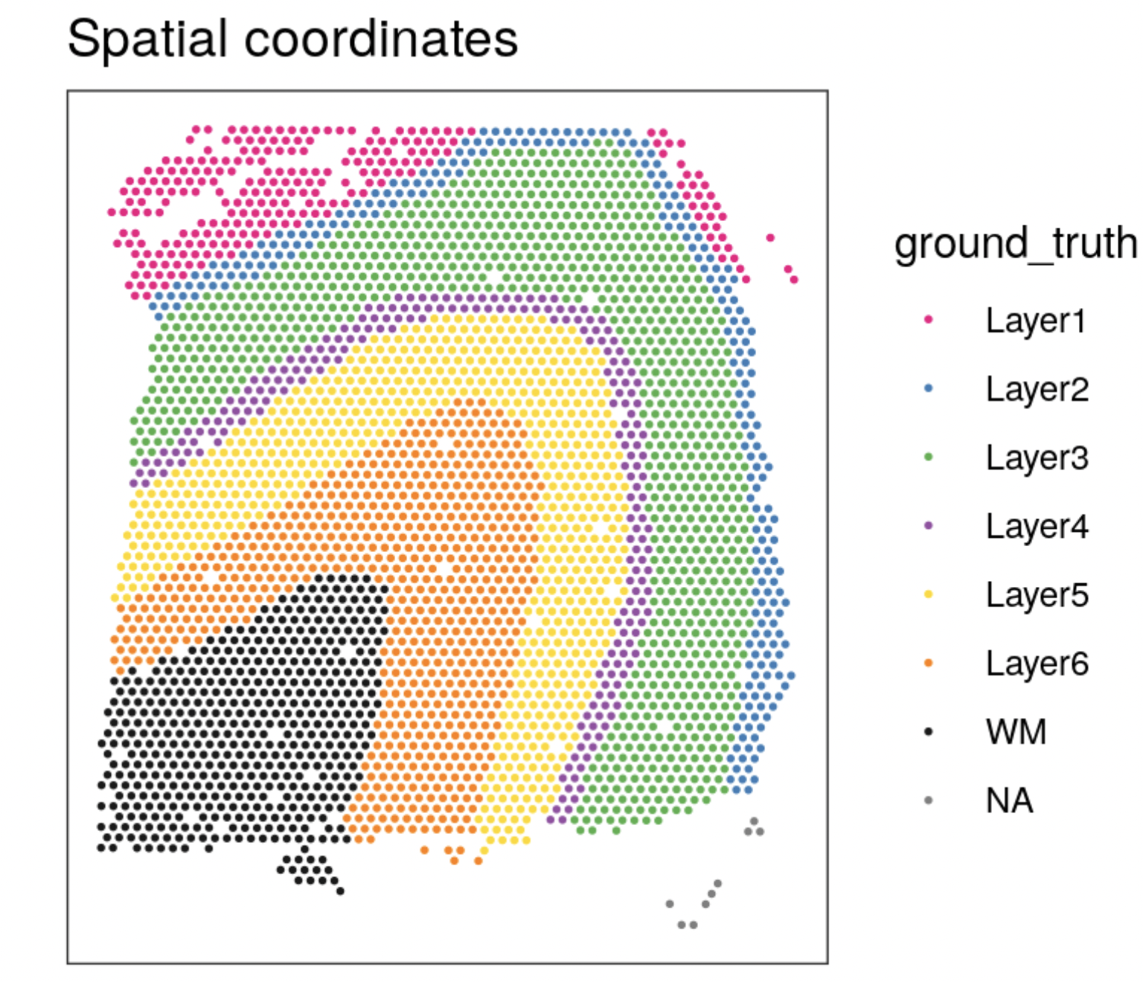
Dataset Description
Load data
QC
Normalization
Feature selection
Dimensionality reduction
Clustering
Marker genes
We will use 10x Genomics Visium dataset generated from healthy human brain sample 151673 from the dorsolateral prefrontal cortex (DLPFC) region in Kristen R. Maynard et al. (2021)
The sample spans the six layers of the cortex plus white matter in a perpendicular tissue section.

Slide 20
Download and load packages in current R environment
Load data
QC
Normalization
Feature selection
Dimensionality reduction
Clustering
Marker genes
Download packages
bio_pkgs = c("SpatialExperiment", "STexampleData", "ggspavis", "scater",
"scran", "nnSVG")
BiocManager::install(bio_pkgs)
install.packages(“pheatmap”)
install.packages(“dplyr”)
Load packages
library(pheatmap)
library(dplyr)
invisible(lapply(bio_pkgs, function(x) library(x, character.only=TRUE)))

Slide 21
Load pre-built dataset
Load data
QC
Normalization
Feature selection
Dimensionality reduction
Clustering
Marker genes
Load dataset
spe = Visium_humanDLPFC()
same with
spe <- Visium_humanDLPFC()

Slide 22
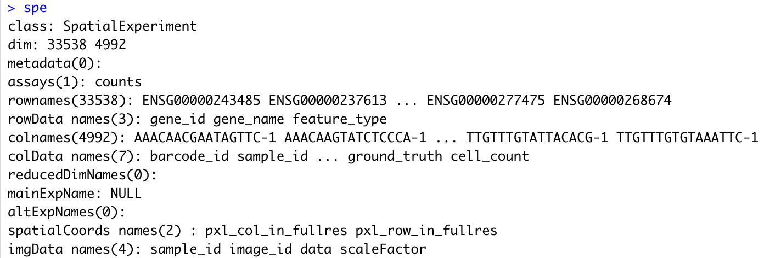
Explore our data – Overall data
Load data
QC
Normalization
Feature selection
Dimensionality reduction
Clustering
Marker genes
Explore overall data
spe
# genes # spots

Slide 23
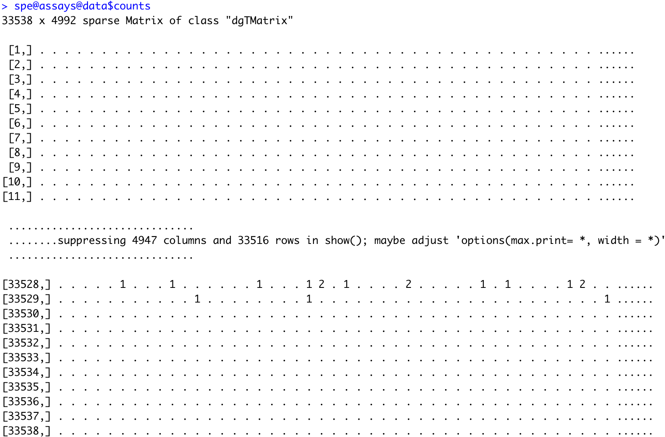
Explore our data – Count data
Load data
QC
Normalization
Feature selection
Dimensionality reduction
Clustering
Marker genes
Explore Count data
spe@assays@data$counts

Slide 24
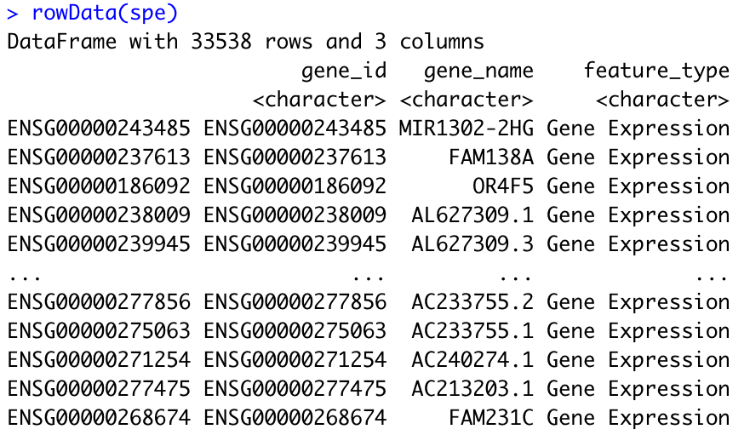
Explore our data – Row data
Load data
QC
Normalization
Feature selection
Dimensionality reduction
Clustering
Marker genes
Explore row data
rowData(spe)

Slide 25
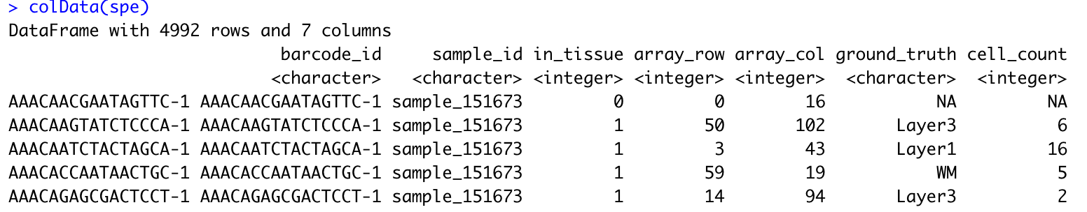
Explore our data – Column data
Load data
QC
Normalization
Feature selection
Dimensionality reduction
Clustering
Marker genes
Explore column data
colData(spe)

Slide 26
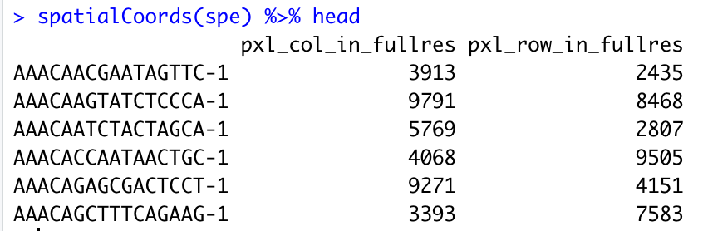
Explore our data – Spatial coordinates data
Load data
QC
Normalization
Feature selection
Dimensionality reduction
Clustering
Marker genes
Explore spatial coordinates data
spatialCoords(spe) %>% head

Slide 27
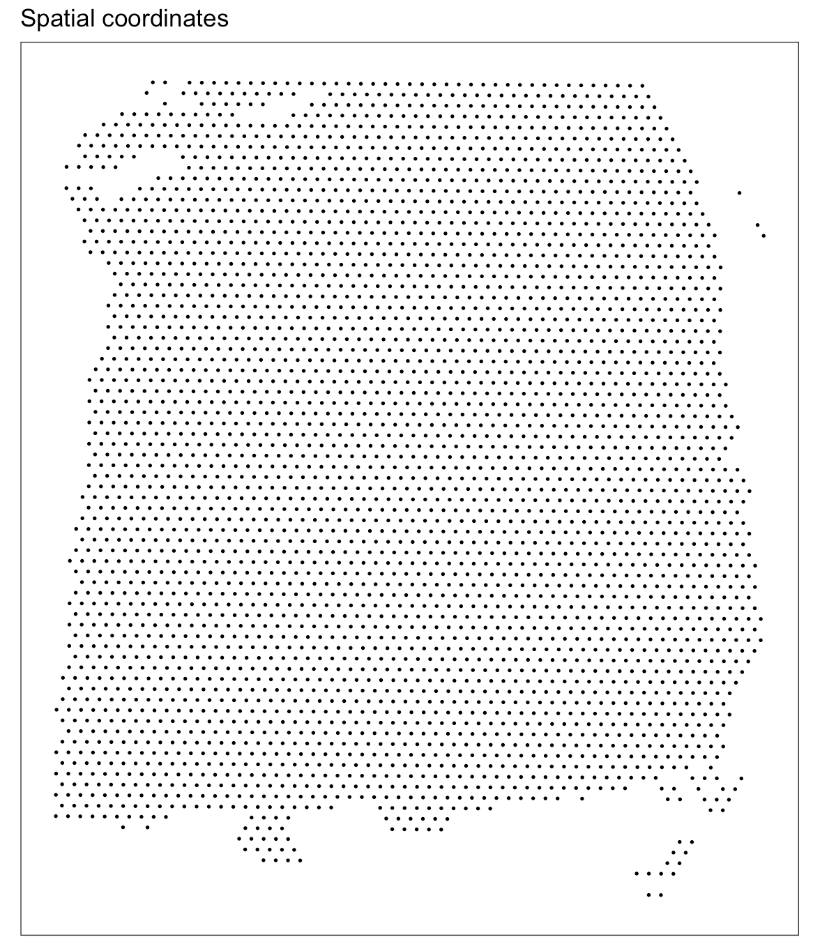
Explore our data – Image
Load data
QC
Normalization
Feature selection
Dimensionality reduction
Clustering
Marker genes
Explore Image
plotSpots(spe)

Slide 28
Quality Control – Spots over tissue (1/2)
Load data
QC
Normalization
Feature selection
Dimensionality reduction
Clustering
Marker genes
Check spot position
plotVisium(spe, highlight = "in_tissue")

Slide 29
Quality Control – Spots over tissue (2/2)
Load data
QC
Normalization
Feature selection
Dimensionality reduction
Clustering
Marker genes
Keep spots over tissue
spe = spe[, colData(spe)$in_tissue == 1]
plotVisium(spe, highlight = "in_tissue")

Slide 30
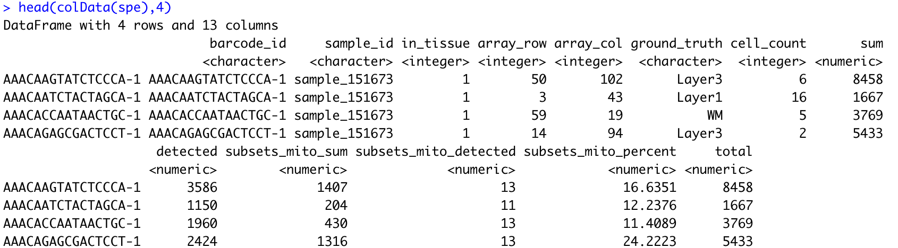
Quality Control – Calculate QC metrics
Load data
QC
Normalization
Feature selection
Dimensionality reduction
Clustering
Marker genes
Calculate QC metrics
is_mito = grepl("(^MT-)|(^mt-)", rowData(spe)$gene_name)
spe = addPerCellQC(spe, subsets = list(mito = is_mito))
head(colData(spe),4)

Slide 31
Quality Control – Select threshold for library size
Load data
QC
Normalization
Feature selection
Dimensionality reduction
Clustering
Marker genes
Select threshold
hist(colData(spe)$sum, breaks = 30)
abline(v=600, col = 'red3’)
Label spots under threshold as TRUE
qc_lib_size = colData(spe)$sum < 600
colData(spe)$qc_lib_size = qc_lib_size

Slide 32
Quality Control – Select threshold for mt gene percent
Load data
QC
Normalization
Feature selection
Dimensionality reduction
Clustering
Marker genes
Select threshold
hist(colData(spe)$subsets_mito_percent, breaks = 20)
abline(v=28, col = 'red3')
Label spots over threshold as TRUE
qc_mito = colData(spe)$subsets_mito_percent > 28
colData(spe)$qc_mito = qc_mito

Slide 33
Quality Control – Select threshold # expressed gene
Load data
QC
Normalization
Feature selection
Dimensionality reduction
Clustering
Marker genes
Select threshold
hist(colData(spe)$detected, breaks = 20)
abline(v=400, col = 'red3')
Label spots under threshold as TRUE
qc_detected = colData(spe)$detected < 400
colData(spe)$qc_detected = qc_detected

Slide 34
Quality Control – Select threshold # cells per spot
Load data
QC
Normalization
Feature selection
Dimensionality reduction
Clustering
Marker genes
Select threshold
hist(colData(spe)$cell_count, breaks = 20)
abline(v=10, col = 'red3')
Label spots over threshold as TRUE
qc_cell_count = colData(spe)$cell_count > 10
colData(spe)$qc_cell_count = qc_cell_count

Slide 35
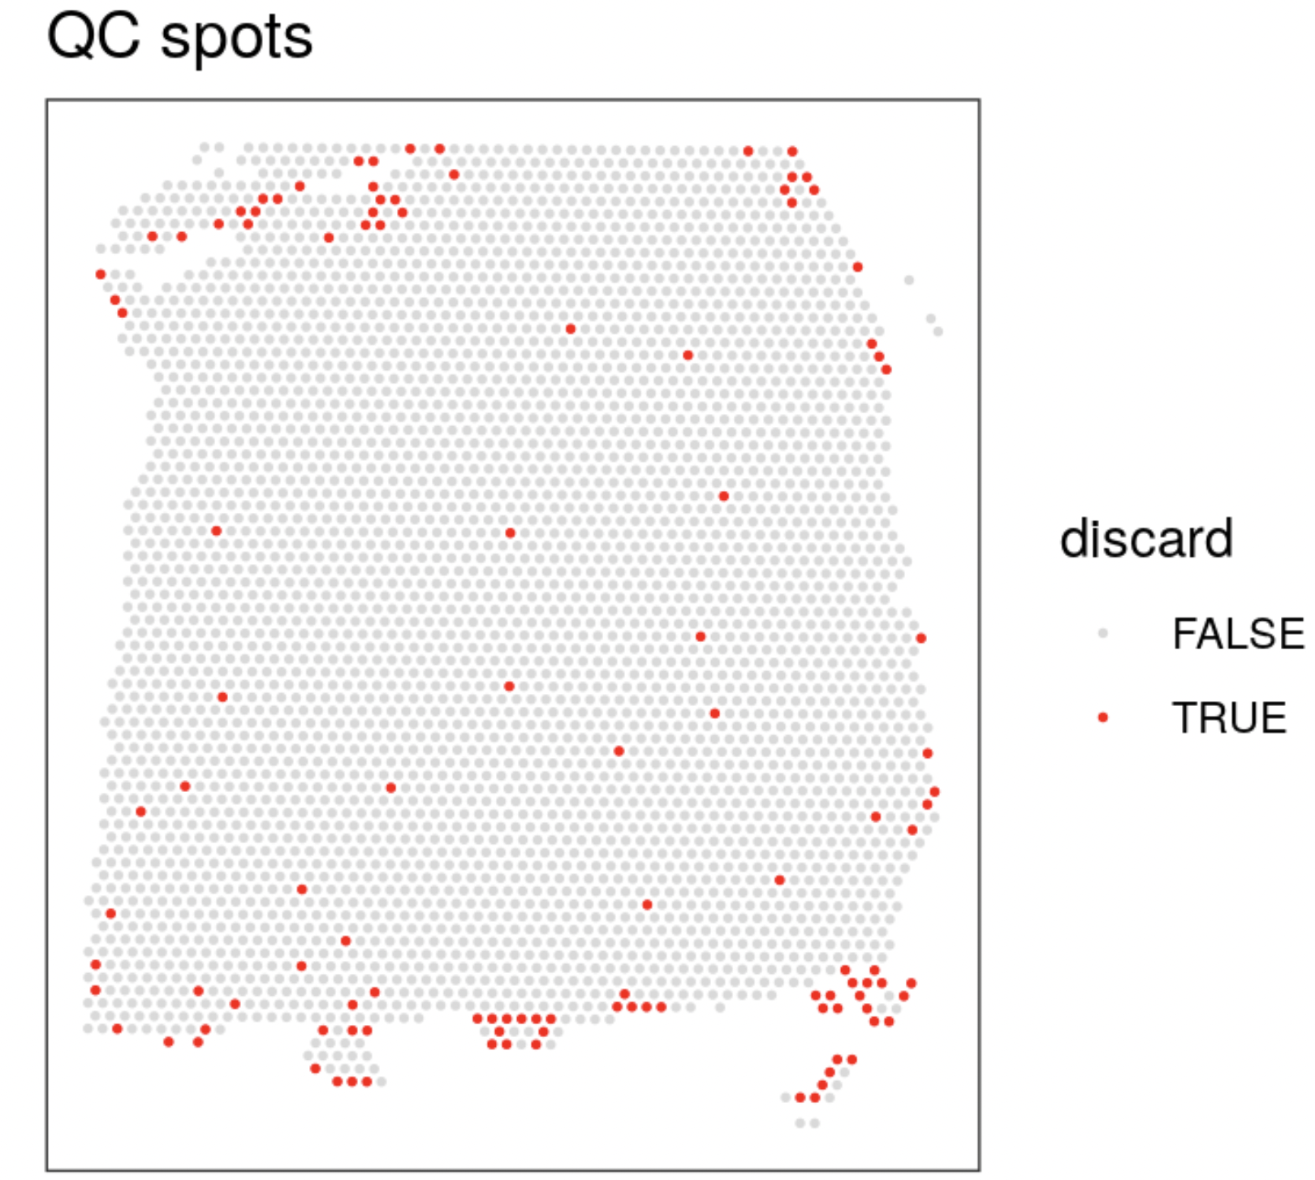
Quality Control – Remove low quality spots (labeled TRUE)
Load data
QC
Normalization
Feature selection
Dimensionality reduction
Clustering
Marker genes
Label spots with low quality
discard = qc_lib_size | qc_detected | qc_mito | qc_cell_count
colData(spe)$discard = discard
Check spots to be discarded
plotQC(spe, type = "spots", discard = "discard")
Remove low quality spots
spe = spe[, !colData(spe)$discard]

Slide 36
Normlization – Log transformation with the library size factors methodology
Load data
QC
Normalization
Feature selection
Dimensionality reduction
Clustering
Marker genes
Calculate logcounts
spe = computeLibraryFactors(spe)
spe = logNormCounts(spe)
Normalized count = log((counts/librarysizefactor) + 1)

Slide 37
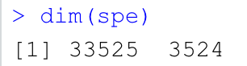
Feature Selection – Remove Mitochondrial genes
Load data
QC
Normalization
Feature selection
Dimensionality reduction
Clustering
Marker genes
We will identify a set of top highly variable genes (HVGs) to define cell types. We use methods from scran, treating spots as equivalent to single cells, and considering only molecular features (gene expression). We first filter out mitochondrial genes, since these genes are very highly expressed and not of main biological interest here.
Remove mitochondrial genes
spe = spe[!is_mito, ]
dim(spe)

Slide 38
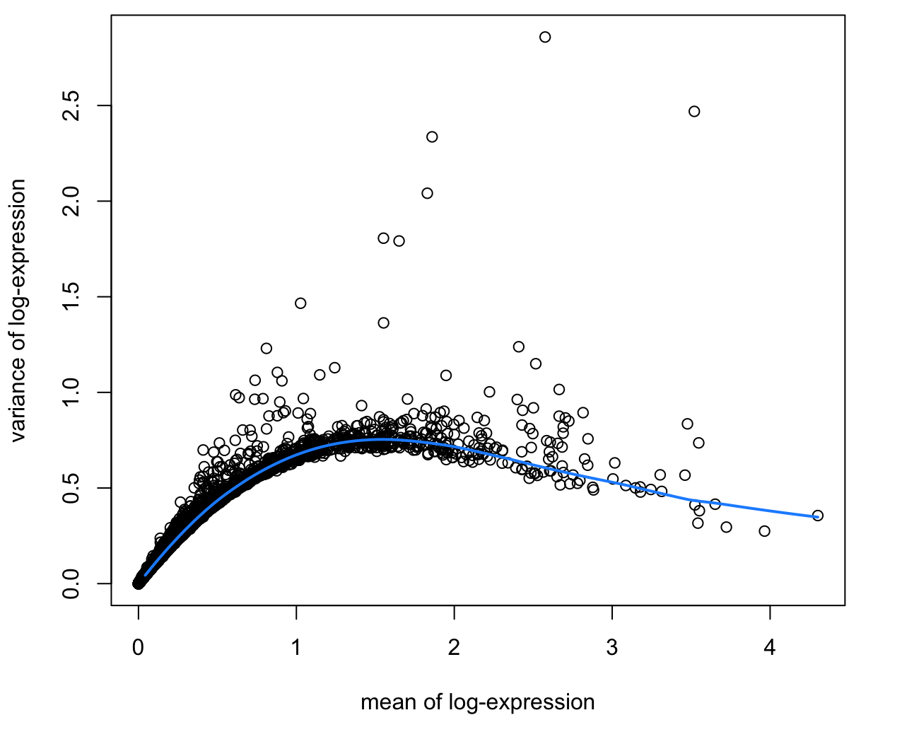
Feature Selection – Mean-variance relationship
Load data
QC
Normalization
Feature selection
Dimensionality reduction
Clustering
Marker genes
Fit and visualize mean-variance relationship
dec = modelGeneVar(spe)
fit = metadata(dec)
plot(fit$mean, fit$var,
xlab = "mean of log-expression", ylab = "variance of log-expression")
curve(fit$trend(x), col = "dodgerblue", add = TRUE, lwd = 2)
top_hvgs = getTopHVGs(dec, prop = 0.1)

Slide 39
Spatially-aware feature selection using nnSVG
Load data
QC
Normalization
Feature selection
Dimensionality reduction
Clustering
Marker genes
Run nnSVG to identify a set of top spatially variable genes (SVGs) instead of HVGs.
We will run nnSVG using a small subset of the dataset for faster runtime.
For a full analysis, it takes around 45 minutes for one Visium slide on a standard laptop using multiple cores.
library(nnSVG)

Slide 40
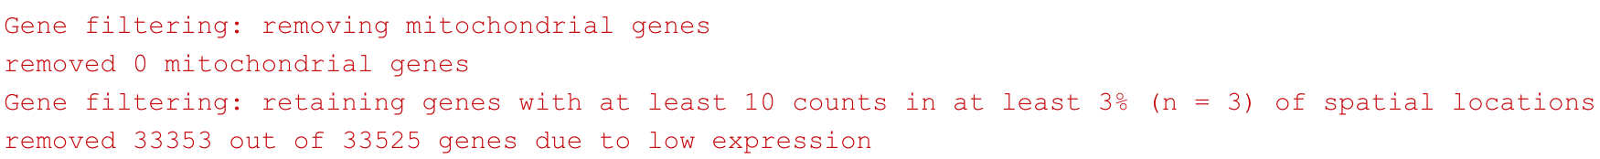
Spatially-aware feature selection – Subsampling
Load data
QC
Normalization
Feature selection
Dimensionality reduction
Clustering
Marker genes
Subsample random 100 spots
n = 100
set.seed(123)
ix = sample(seq_len(n), n)
spe_nnSVG = spe[, ix]
Filter low-expressed and mitochondrial genes
spe_nnSVG = filter_genes(spe_nnSVG, filter_genes_ncounts = 10, filter_genes_pcspots = 3)

Slide 41
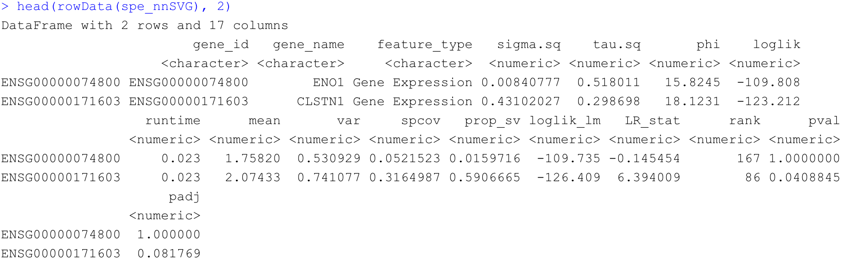
Spatially-aware feature selection – run nnSVG
Load data
QC
Normalization
Feature selection
Dimensionality reduction
Clustering
Marker genes
Re-calculate log counts after filtering using library size factors
spe_nnSVG = logNormCounts(spe_nnSVG)
Run nnSVG
set.seed(123)
spe_nnSVG = nnSVG(spe_nnSVG, n_threads = 1)
head(rowData(spe_nnSVG), 2)

Slide 42
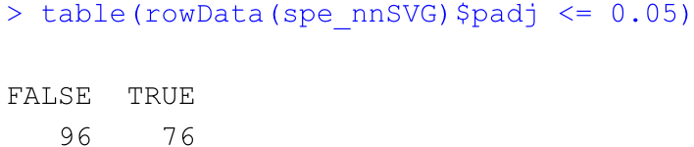
Spatially-aware feature selection – results
Load data
QC
Normalization
Feature selection
Dimensionality reduction
Clustering
Marker genes
Number of significant SVGs
table(rowData(spe_nnSVG)$padj <= 0.05)

Slide 43
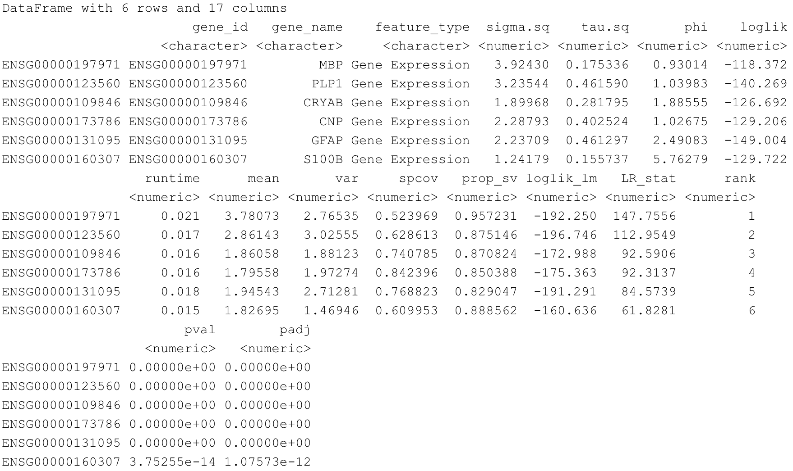
Spatially-aware feature selection – results
Load data
QC
Normalization
Feature selection
Dimensionality reduction
Clustering
Marker genes
Results for top n SVGs
rowData(spe_nnSVG)[order(rowData(spe_nnSVG)$rank)[1:6], ]

Slide 44
Dimensionality reduction
Load data
QC
Normalization
Feature selection
Dimensionality reduction
Clustering
Marker genes
To reduce noise and to improve computational efficiency, we will run principal component analysis (PCA) on the set of top HVGs.
We will retain the top 50 principal components (PCs) for further downstream analysis
We also run Uniform Manifold Approximation and Projection for Dimension Reduction (UMAP) on the set of top 50 PCs and retain the top 2 UMAP components for visualization purposes

Slide 45
What is Dimensionality reduction?
Load data
QC
Normalization
Feature selection
Dimensionality reduction
Clustering
Marker genes
Dimension increases as genes (features) are added. – “curse of dimensionality”
Not all genes are important to classify the cells into meaningful clusters.
Need to reduce the number of features to the most relevant ones in simple terms.
Max
Gene C
Gene B
Min
Gene A
Max
Gene B
Gene A
Min
Gene A
Max

Slide 46
What is PCA and UMAP?
Load data
QC
Normalization
Feature selection
Dimensionality reduction
Clustering
Marker genes
PCA (Principal Component Analysis)
The axis that explains the maximum amount of variance in the training set is called the Principal Components.
UMAP (Uniform Manifold Approximation and Projection)
UMAP is a nonlinear dimensionality reduction method, it is very effective for visualizing clusters or groups of data points and their relative proximities.

Slide 47
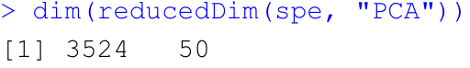
Dimensionality reduction - PCA
Load data
QC
Normalization
Feature selection
Dimensionality reduction
Clustering
Marker genes
Compute PCA
set.seed(123)
spe = runPCA(spe, subset_row = top_hvgs) reducedDimNames(spe)
dim(reducedDim(spe, "PCA"))

Slide 48
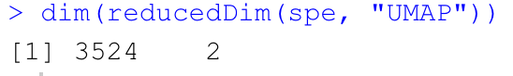
Dimensionality reduction - UMAP
Load data
QC
Normalization
Feature selection
Dimensionality reduction
Clustering
Marker genes
Compute UMAP on top 50 Principal components
set.seed(123)
spe = runUMAP(spe, dimred = "PCA")
reducedDimNames(spe)
dim(reducedDim(spe, "UMAP"))
# update column names for easier plotting
colnames(reducedDim(spe, "UMAP")) = paste0("UMAP", 1:2)

Slide 49
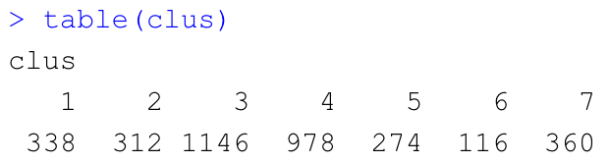
Clustering
Load data
QC
Normalization
Feature selection
Dimensionality reduction
Clustering
Marker genes
Perform clustering to define cell types.
Spots sharing common features are clustered.
Graph-based clustering and Store cluster labels in column 'label' in colData
set.seed(123)
k = 10
g = buildSNNGraph(spe, k = k, use.dimred = "PCA")
g_walk = igraph::cluster_walktrap(g)
clus = g_walk$membership
table(clus)
colLabels(spe) = factor(clus)

Slide 50
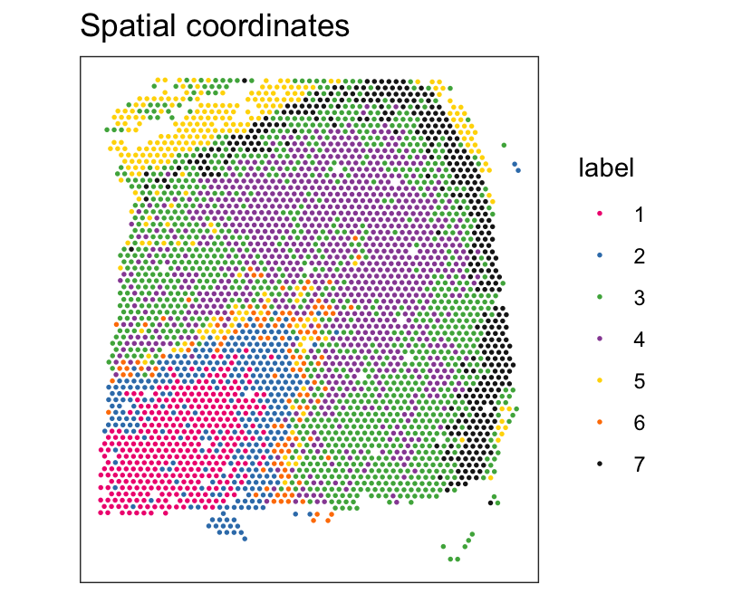
Visualize the clusters on the tissue slide
Load data
QC
Normalization
Feature selection
Dimensionality reduction
Clustering
Marker genes
plot clusters in spatial x-y coordinates
plotSpots(spe, annotate = "label", palette = "libd_layer_colors")

Slide 51
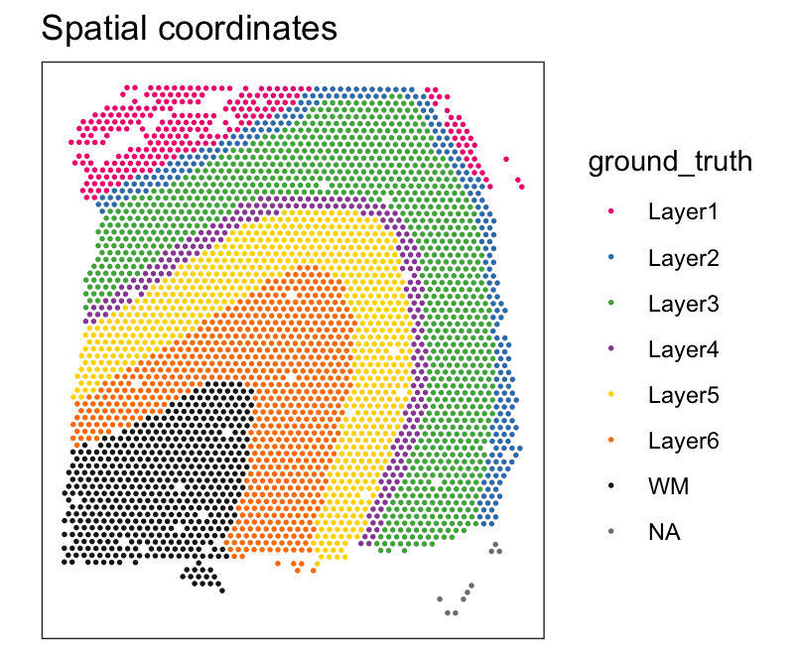
Visualize ground truth labels on the tissue slide
Load data
QC
Normalization
Feature selection
Dimensionality reduction
Clustering
Marker genes
plot ground truth in spatial x-y coordinates
plotSpots(spe, annotate = "ground_truth", palette = "libd_layer_colors")

Slide 52
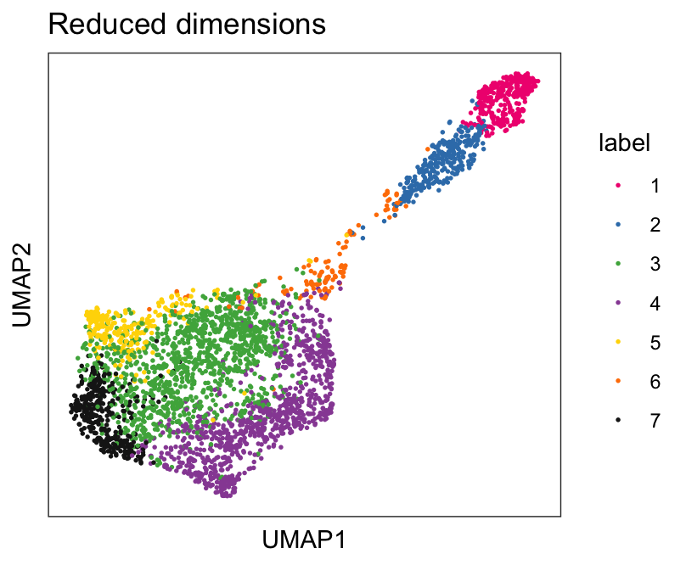
Visualize the clusters in UMAP reduced dimension
Load data
QC
Normalization
Feature selection
Dimensionality reduction
Clustering
Marker genes
plot clusters in UMAP reduced dimensions
plotSpots(spe, annotate = "label", palette = "libd_layer_colors")

Slide 53
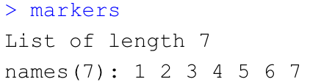
Identify marker genes
Load data
QC
Normalization
Feature selection
Dimensionality reduction
Clustering
Marker genes
Identify marker genes by testing for differential gene expression between clusters
With marker genes, we could annotate (characterize) each clusters
plot clusters in UMAP reduced dimensions
# set gene symbols as row names for easier plotting
rownames(spe) = rowData(spe)$gene_name
# test for marker genes
markers = findMarkers(spe, test = "binom", direction = "up")
# returns a list with one DataFrame per cluster
markers

Slide 54
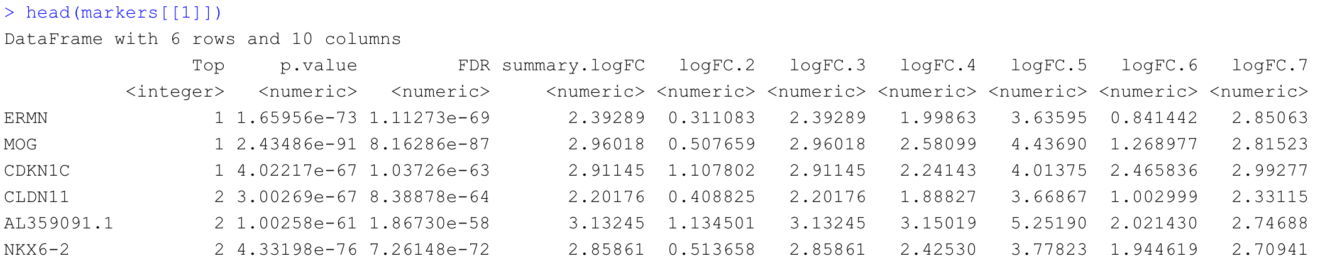
Examine marker genes
Load data
QC
Normalization
Feature selection
Dimensionality reduction
Clustering
Marker genes
We can access to marker genes information from a list we generated.
Marker genes of cluster 1
head(markers$`1`) # or head(markers[[1]])
interesting = markers[[1]]

Slide 55
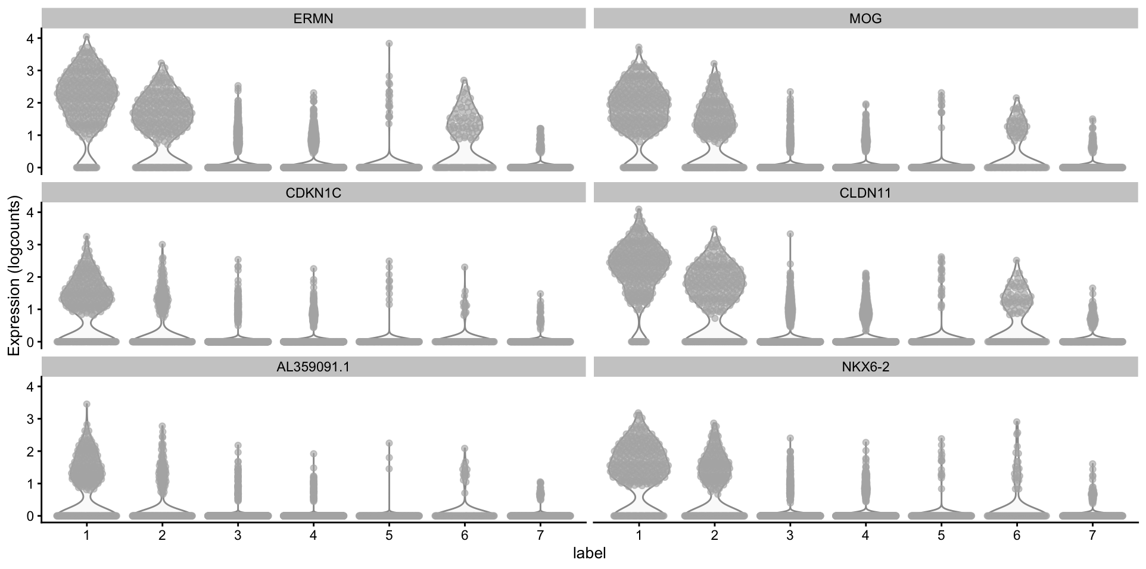
Log-transformed normalized expression
Load data
QC
Normalization
Feature selection
Dimensionality reduction
Clustering
Marker genes
plot log-transformed normalized expression of top genes for one cluster
top_genes = head(rownames(interesting))
plotExpression(spe, x = "label", features = top_genes)

Slide 56
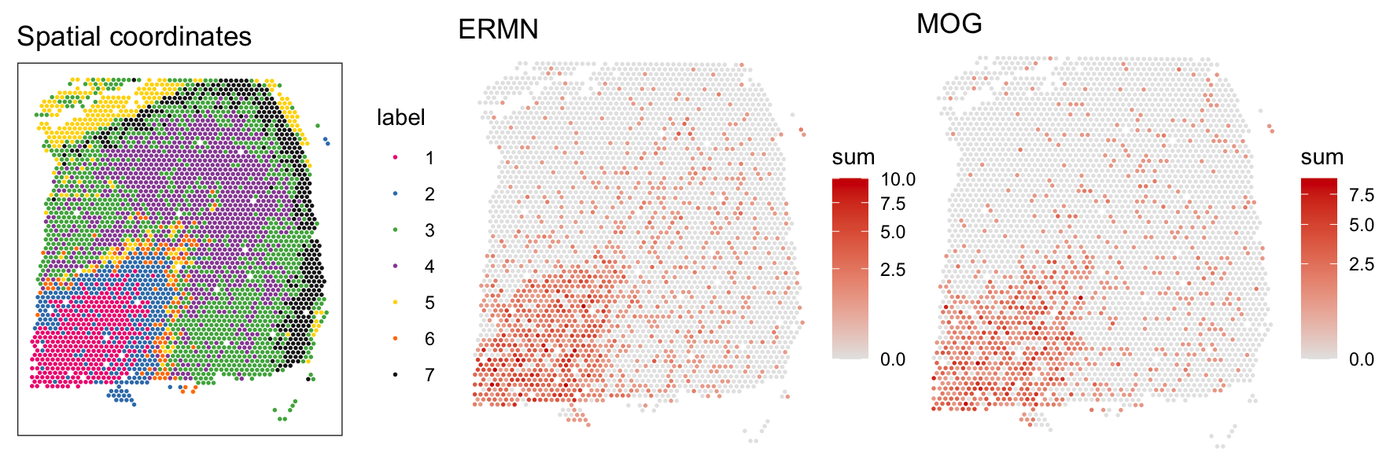
Log-transformed normalized expression
Load data
QC
Normalization
Feature selection
Dimensionality reduction
Clustering
Marker genes
plot log-transformed normalized expression on Spatial Coordinates
p = plotSpots(spe, annotate = "label", palette = "libd_layer_colors")
p1 = plotMolecules(spe, molecule = top_genes[1], palette = c(“gray90”, “red3”))+scale_y_reverse()
p2 = plotMolecules(spe, molecule = top_genes[2], palette = c(“gray90”, “red3”))+scale_y_reverse()
cowplot::plot_grid(p, p1, p2, ncol=3)

Slide 57
Summary
Use SpaceRanger to generate a gene-spot matrix file from 10X Genomics Visium sequence data (FASTQ files)
Basic R programming for the spatial transcriptomics analysis
Load the Visium dataset and understand the structure
Understand overall preprocessing steps (QC & Normalization)
Understand the feature selection (HVG/SVG) and Dimension reduction (PCA)
Cluster spots using SNN and visualize them in UMAP space
Find marker genes that markedly represent each cluster

Slide 58
Q & A

